Slide 1
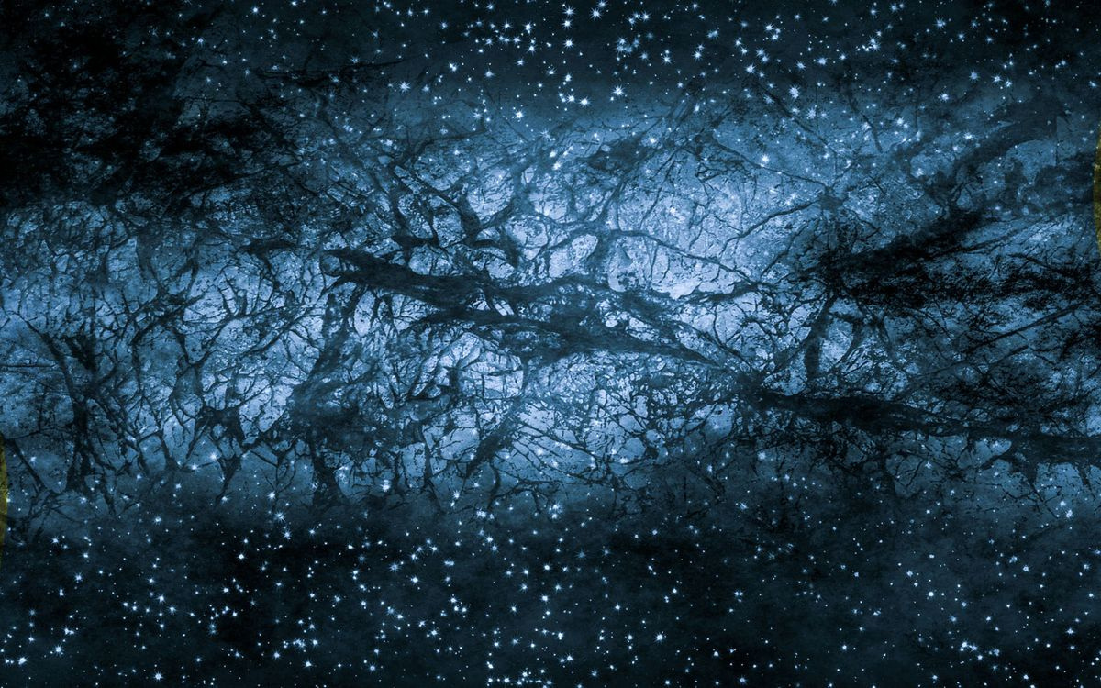
A DEEP DIVE INTO
DARK MATTER
BY ARIC APOORV AND UJJWAL RAJ

Slide 2

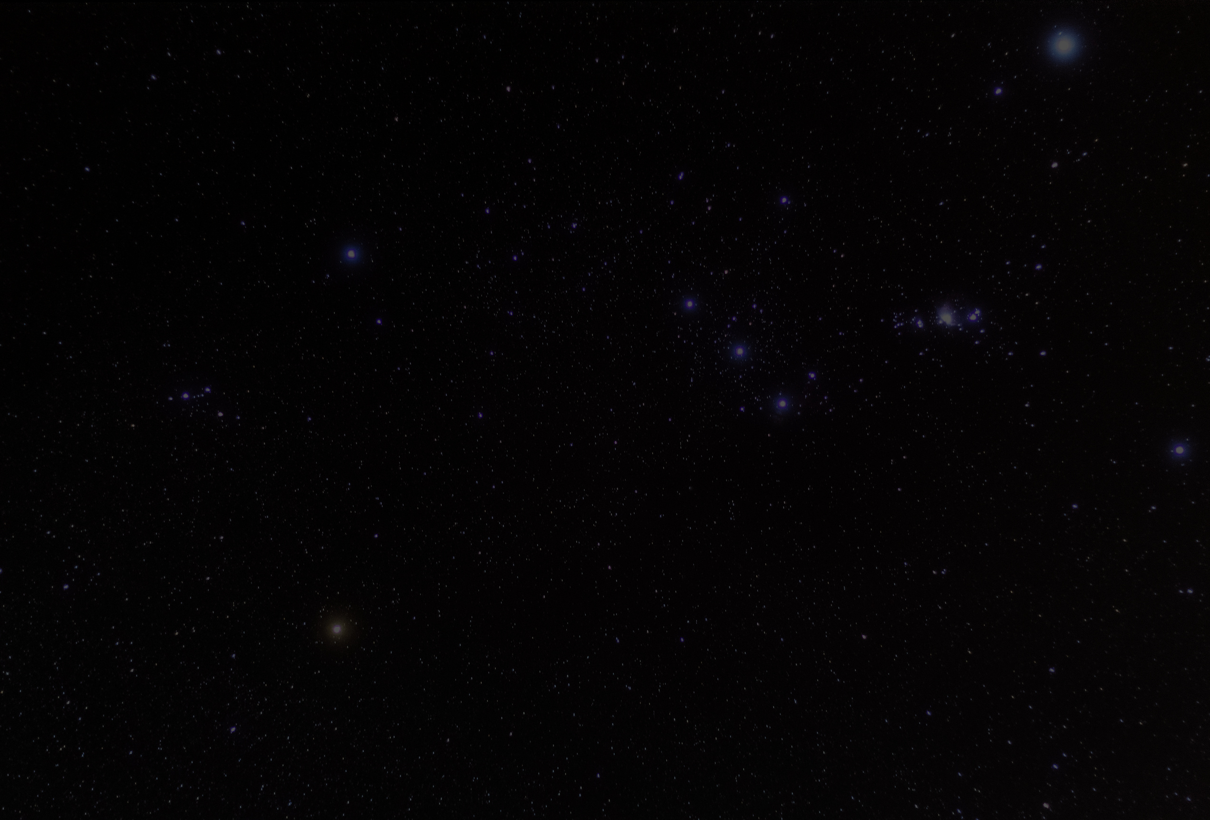

CONTENTS
Dark Matter : A Fundamental Challenge to Physics
Why do we beleive in Dark Matter?
Dark Matter detection techniques
Dark Matter Cadidates
Role of Dark Matter
Key Takeaways

Slide 3
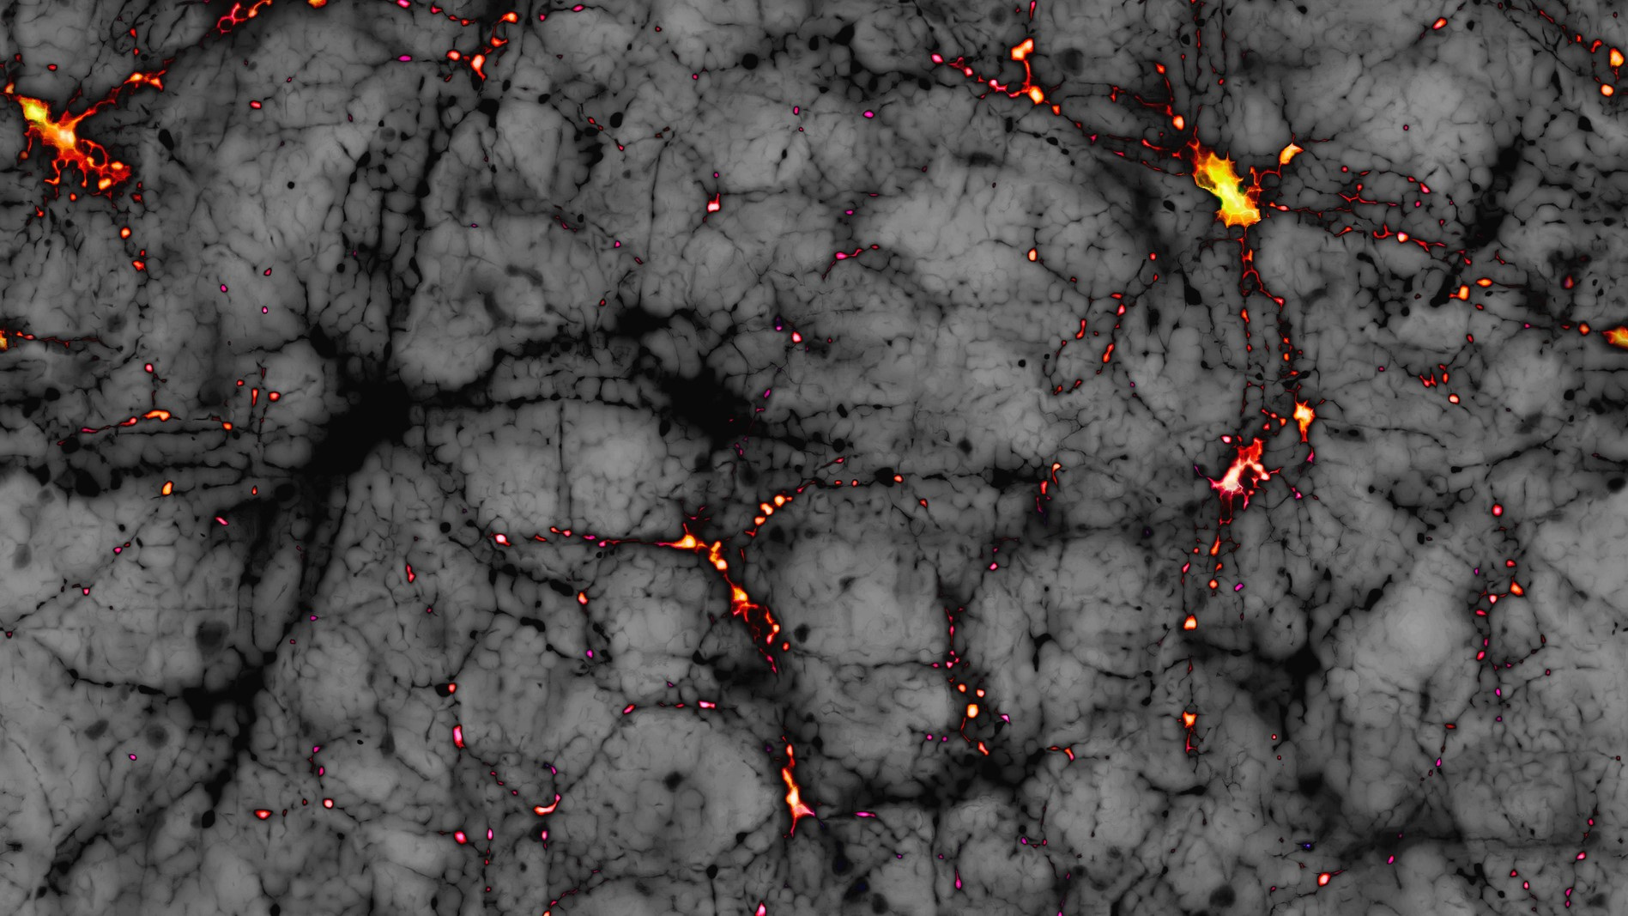
DARK MATTER
A FUNDAMENTAL CHALLENGE TO PHYSICS

Slide 4
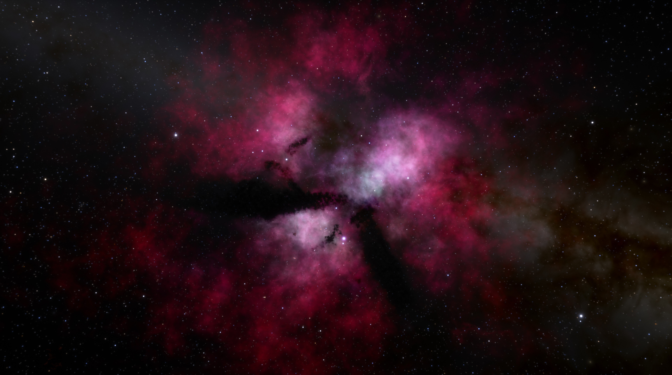
Invisible to conventional telescopes.
Does not interact with electromagnetic forces.
Detected only through indirect methods such as gravitational effects.
Nothing is known about its composition.
Accounts for nearly 27% of Universe’s mass and energy.
•

Slide 5

HOW DARK MATTER RESHAPES PHYSICS

Slide 6
1.Standard Model of Particle Physics Is Incomplete:
Does not account for Dark Matter.
Possible new particles could redefine physics.
2.Dark Matter and the Fate of the Universe:
Unclear role in the universe's expansion.
Interaction with Dark Energy might determine universe's ultimate fate.

Slide 7
3.Alternative Theories: Modified Newtonian Dynamics (MOND):
Stars in outer part of galaxies have larger speed than expected.
Gravity behaves differently at cosmic scales like at the edge of galaxies.
Gravity increases for objects with very less acceleration.
This modifies Newton’s Second Law.
This explains flat rotation curves of galaxies without the need of dark matter.

Slide 8
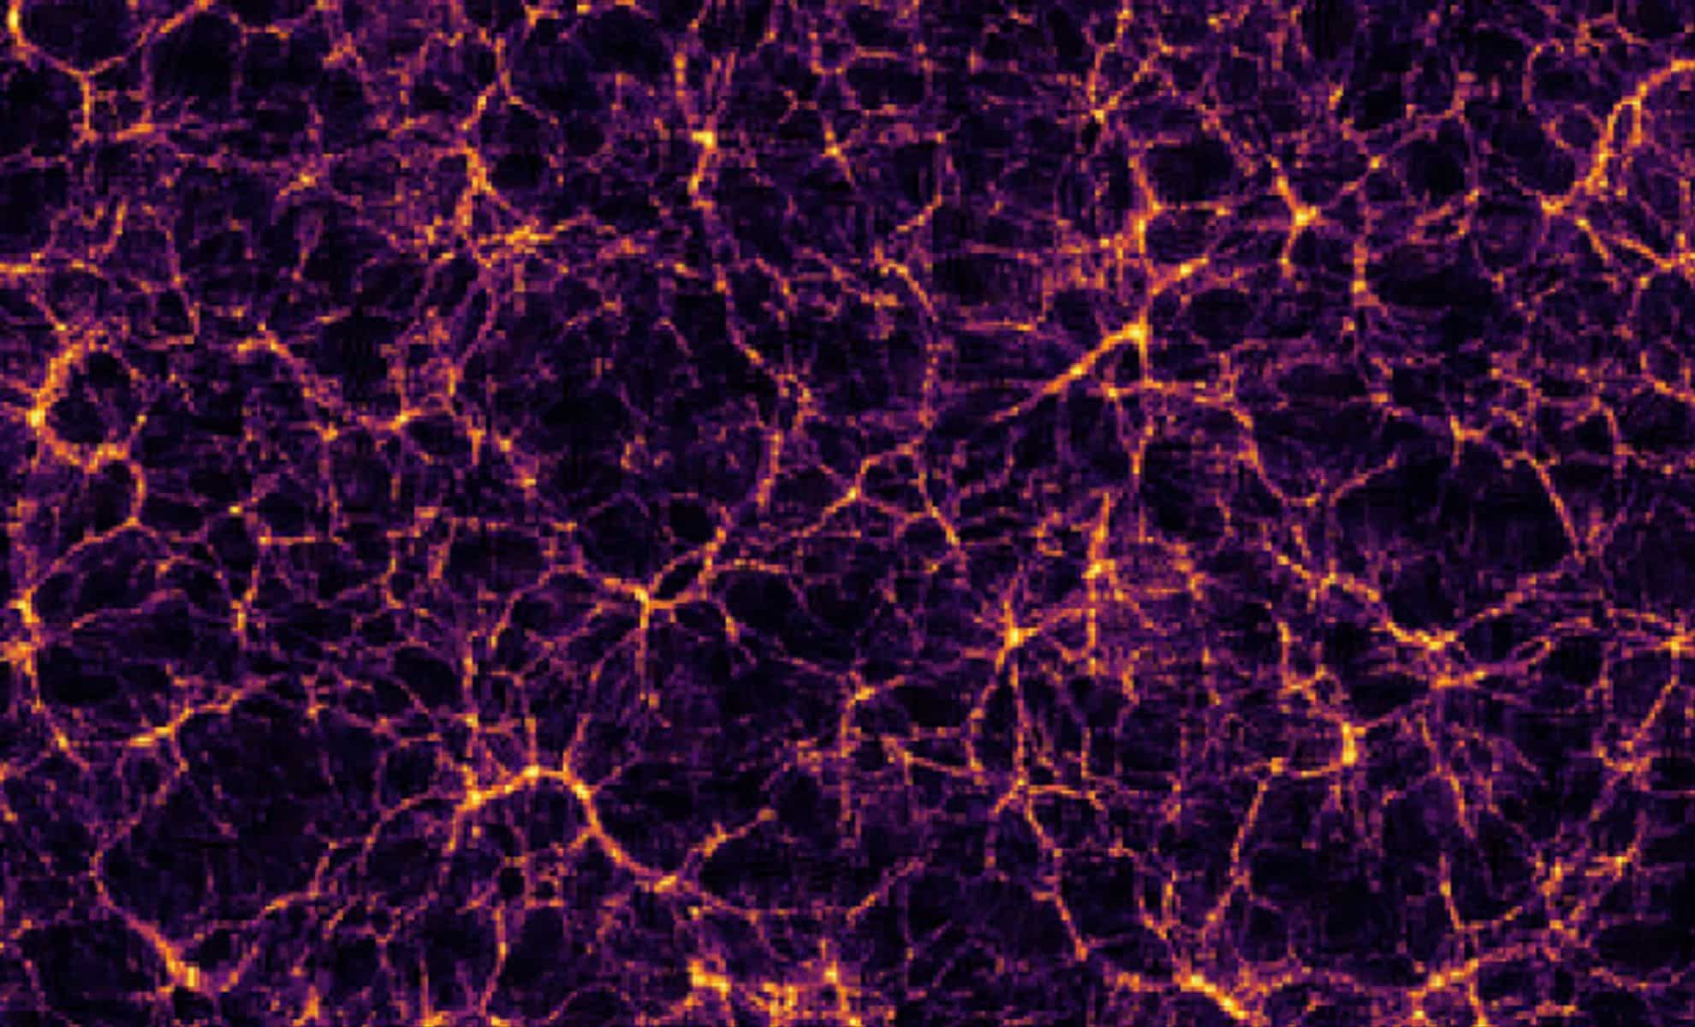
WHY DO WE BELEIVE IN DARK MATTER?

Slide 9

Galaxy Rotation Curves:
Gravitational
Lensing:
Outer stars in galaxies move as fast as inner stars defying normal laws of physics.
This implies presence of invisible mass preventing galaxies from flying apart.
Dark matter explains stability of galaxies.
Light bends near massive objects.
Stronger-than-expected lensing effects in some galaxies and celestial objects suggests unseen mass implying the presence of dark matter.

Slide 10
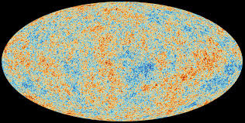
Cosmic Microwave Background (CMB)
CMB : A type of microwave radiation that is present everywhere in space.
Released during Big Bang.
Studying CMB shows patterns in Universe normal matter can’t explain.
CMB radiation

Slide 11
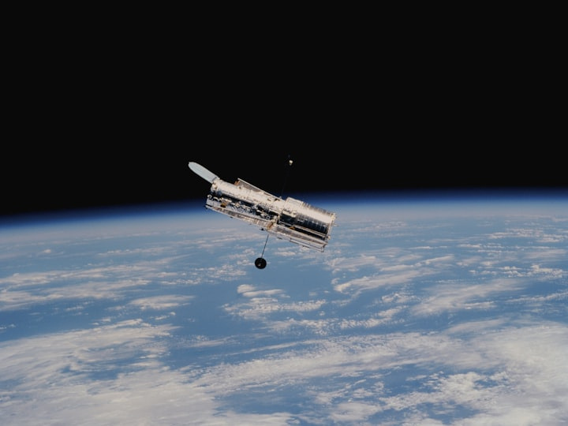
Dark Matter Detection Techniques

Slide 12
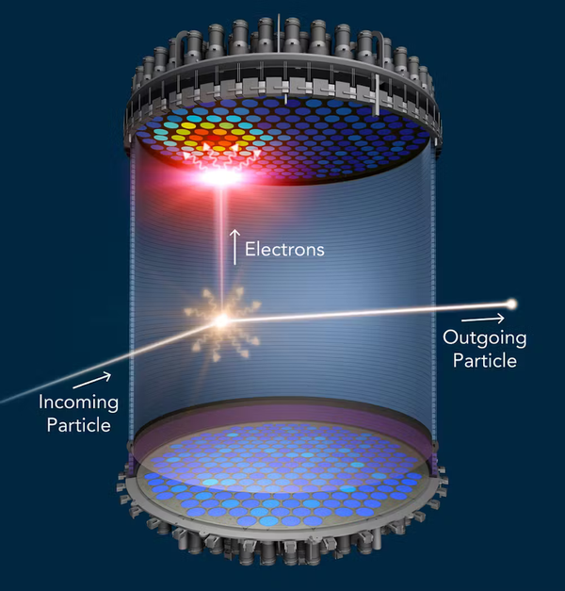
Underground detectors:
Looking for weak interactions between normal particles and dark matter.
Shielded by Cosmic radiations and radioactivity.
Examples include cryogenic setups and liquid xenon detectors.
2.Indirect Detection:
Observing high-energy particles or gamma rays from potential Dark Matter Annihilation.
Galactic centres, Globular clusters, Neutron Stars can be possible locations of annihilation.
Underground Detector

Slide 13
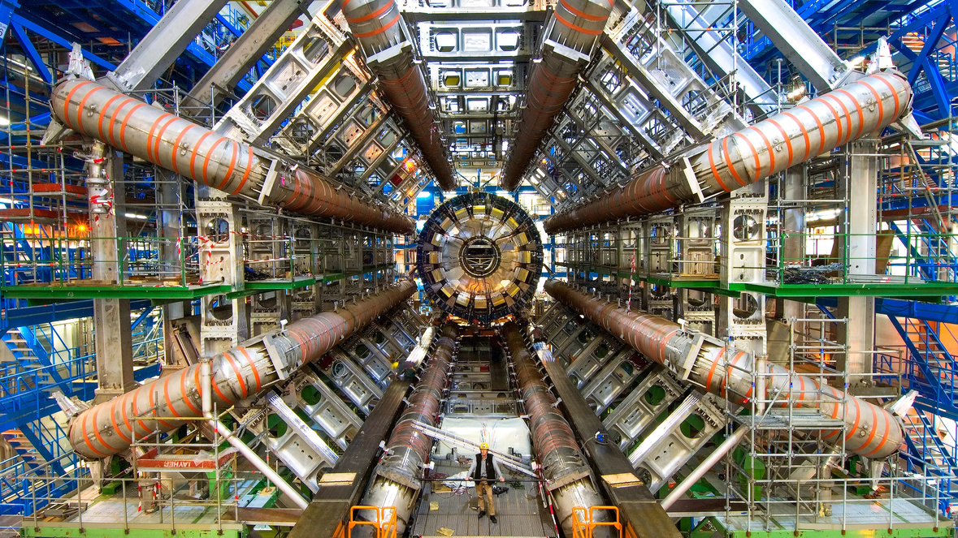
3. Collider Experiments:
Particle accelerators like the LHC ( Large Hadron Collider) attempt to create Dark Matter particles.
By smashing particles together at high speeds, the LHC aims to create conditions where dark matter particles might be produced and detected.
Looking for missing energy signatures in collision events is a possible way.
Large Hadron Collider(LHC)

Slide 14
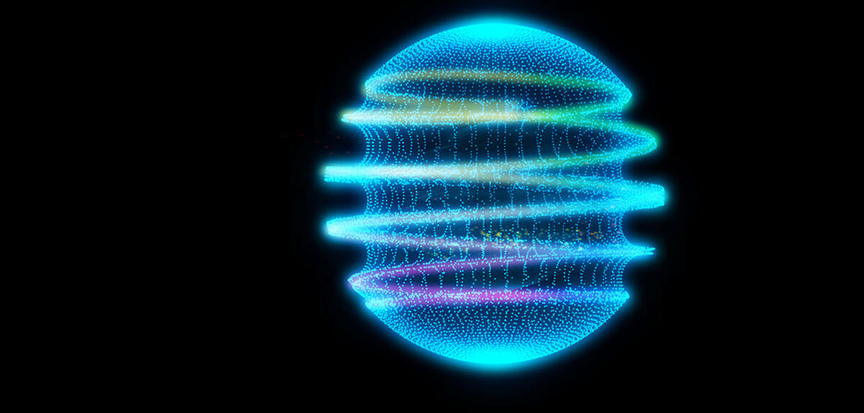
Dark Matter Candidates

Slide 15

1.Weakly Interacting Massive Particles (WIMPs):
Hypothetical particles that interact with forces weaker than weak nuclear force like gravitational.
Predicted by extensions of the Cosmological Model, such as Supersymmetry i.e. for every known particle, there exists a partner particle with different spin properties.
Considered a leading candidate for Dark Matter.

Slide 16
2.Axions:
Hypothetical low-mass particles which interact weakly with other particles.
Detected through experiments like ADMX(Axion Dark Matter Experiment),
3.Sterile Neutrinos:
A type of neutrino that does not interact via the fundamental forces except gravity.

Slide 17
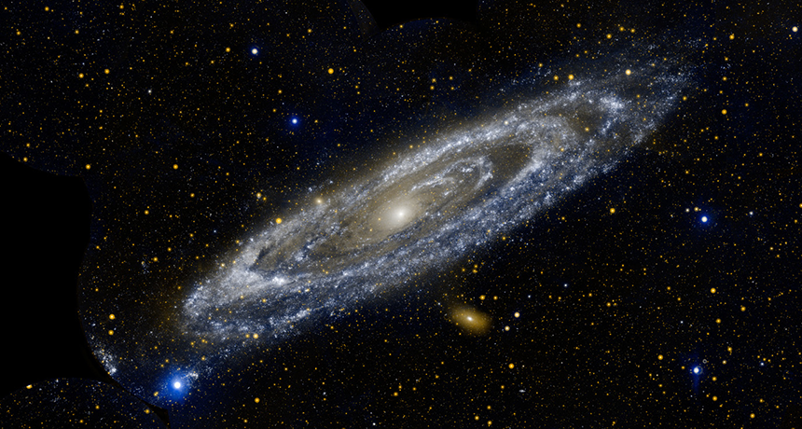
Role of Dark Matter

Slide 18

Structure Formation:
Acts as a gravitational scaffold for galaxies and clusters.
Influences the formation and evolution of cosmic structures.
2.Role in Cosmic History:
Crucial for the emergence of large-scale structures after the Big Bang.
Balances the effects of Dark Energy in the universe.

Slide 19

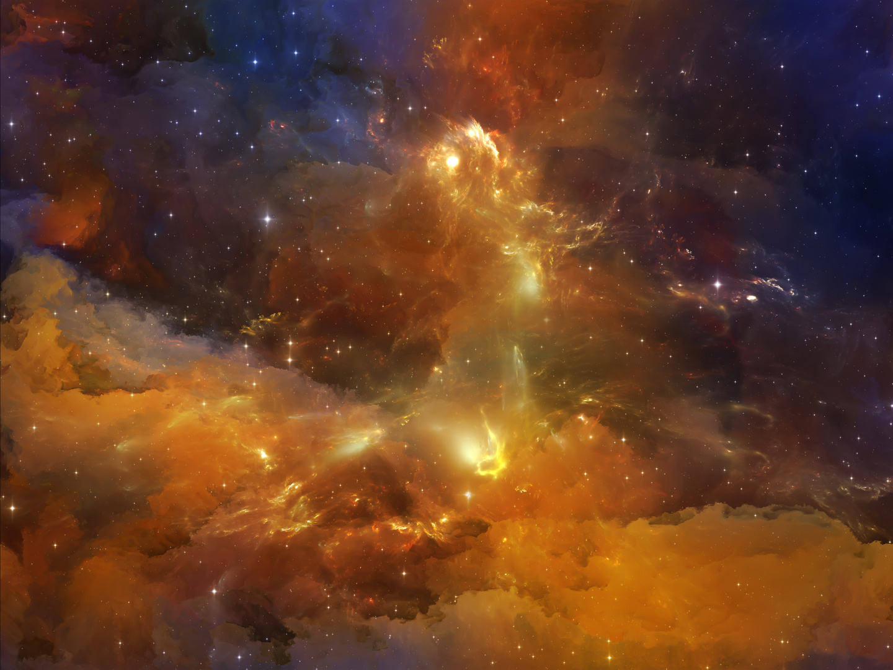
Key Takeaways
Dark Matter is central to understanding cosmic structure and the universe’s fate.
It Challenges the Standard Model, suggesting new physics beyond current paradigms.
The mystery of Dark Matter is a gateway to deeper understanding of reality.

Slide 20

Thank You

